Slide 1
Best Practices in Posters and data visualizations
David Martin
Clinical Research Data Specialist
dnm5ca@virginia.edu
https://guides.hsl.virginia.edu/david-martin

Slide 2
Purpose of today
This session will focus mostly on creating effective poster and data visualizations
While research papers are often restrictive in how you can show off your research/work, posters can often provide some more creative options
I will talk about the best way to get across your ideas in the most efficient, aesthetically pleasing manner by:
Removing superfluous information
Organizing your posters/graphs/tables logically
Making smart aesthetic choices

Slide 3

Before you start
What is the main idea I want to get across?
Not everything can fit on a poster board
The paper is there for the details
Who is the audience?
General Public
Colleagues
Experts
What are the requirements of the poster?
Size/Shape (i.e.: Trifold, single poster board)
Sections
In-person/Virtual
Colors/logos/etc.
https://www.forbes.com/sites/evaamsen/2019/06/18/a-graphic-design-revolution-for-scientific-conference-posters/

Slide 4
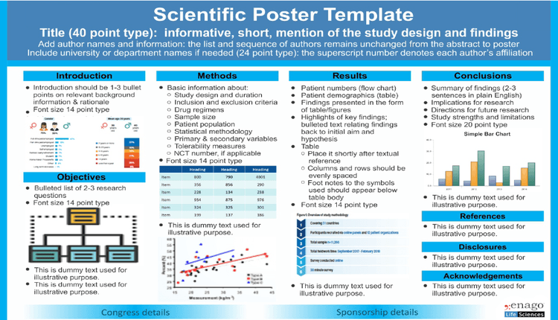
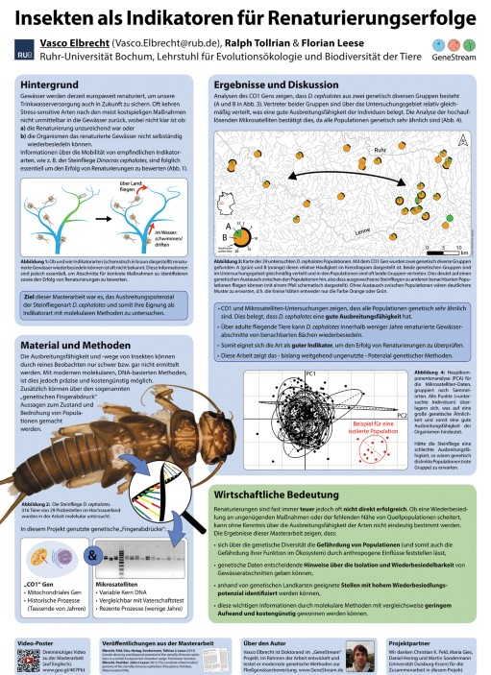
Overall Things to keep in mind
Make it visually appealing, but not distracting
Use graphics/pictures, but not too many
Should be able to be seen from far away
Don’t be too verbose
Keep the word count down as much as possible
Make your point clearly and concisely
White space is ok, no need to cram everything in
Place your sections/section headers before starting
Understand how people read (top to bottom, right to left)
https://www.enago.com/academy/scientific-posters-an-effective-way-of-presenting-research/
https://www.nature.com/articles/nj7614-115a

Slide 5
Specific Sections
Title
Make it short, but catchy
Avoid jargon
Generally, include acknowledgements, name, affiliation, etc
Abstract
Basically the outline for the poster
Often a good place for a flow chart/motivating picture or graph
Introduction/Background
Keep it short and to the point
Watch jargon, unless the audience is highly specific

Slide 6
Specific Sections
Results
Only show the main takeaways, no need for superfluous information
Actual creation of graphs/charts will be talked about later on
Discussion/Conclusion
Much like a research paper, do not add anything new here
Recap the key points from Intro/Results

Slide 7
Aesthetic choices
Generally, use dark text on a light background
Use bullets and headlines
Keep layout, graphics, colors, fonts, width of text boxes, etc. consistent
Use a palette/theme of only 2 or 3 colors
Online palettes exist to help you if you need them
Example:
https://www.canva.com/colors/color-wheel/

Slide 8

What does a bad poster look like?
From: https://colinpurrington.com/2012/02/example-of-bad-scientific-poster/
Notes:
From: https://colinpurrington.com/2012/02/example-of-bad-scientific-poster/
Too much text (I’ve been on mission to push for 800 words).
Background image is distracting (distracts from illustrations).
Text box backgrounds are dark, which makes text really hard to read.
Text box backgrounds are all different colors, for no reason (distracting).
Text boxes are different widths (distracting, hard to follow flow of poster).
Some text boxes too wide (aim for 45-65 characters per line).
Text boxes not separated from each other by pleasing “white” space.
Text box edges not aligned (distracting).
Text justified, which causes bad inter-word spacing. Also makes reading harder (brain uses jaggedness of left-justified text).
Logos are distracting, useless, crowd title.
Title word art distracting, hard to read, juvenile.
Title is in all caps, which is harder to read and obscures Latin name.
Title is italicized, which also obscures Latin name style conventions.
Author font and color is annoying (comic sans should be reserved for comic books).
Author font color is too loud relative to other text.
Results are presented in sentences instead of visually with charts.
Section headers have too much formatting (big font, bolded, italicized, underlined, and colored — ack!). Choose one. [Note: I forgot to number the sections…that would have been even worse.]
Terrible graphic of Guinea pig on scale. Need one of the actual set up (pigs eating while weightless, for example).
Inclusion of an Abstract consumes space needlessly. Abstract section should be banned from posters. Posters ARE an abstract.
Plus the science is terrible! (Bad science is correlated with bad graphic design, by the way.)

Slide 9
What does a bad poster look like?
Notes:
From: https://colinpurrington.com/2012/02/example-of-bad-scientific-poster/
Too much text (I’ve been on mission to push for 800 words).
Background image is distracting (distracts from illustrations).
Text box backgrounds are dark, which makes text really hard to read.
Text box backgrounds are all different colors, for no reason (distracting).
Text boxes are different widths (distracting, hard to follow flow of poster).
Some text boxes too wide (aim for 45-65 characters per line).
Text boxes not separated from each other by pleasing “white” space.
Text box edges not aligned (distracting).
Text justified, which causes bad inter-word spacing. Also makes reading harder (brain uses jaggedness of left-justified text).
Logos are distracting, useless, crowd title.
Title word art distracting, hard to read, juvenile.
Title is in all caps, which is harder to read and obscures Latin name.
Title is italicized, which also obscures Latin name style conventions.
Author font and color is annoying (comic sans should be reserved for comic books).
Author font color is too loud relative to other text.
Results are presented in sentences instead of visually with charts.
Section headers have too much formatting (big font, bolded, italicized, underlined, and colored — ack!). Choose one. [Note: I forgot to number the sections…that would have been even worse.]
Terrible graphic of Guinea pig on scale. Need one of the actual set up (pigs eating while weightless, for example).
Inclusion of an Abstract consumes space needlessly. Abstract section should be banned from posters. Posters ARE an abstract.
Plus the science is terrible! (Bad science is correlated with bad graphic design, by the way.)

Slide 10
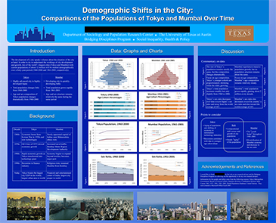
What does a pretty good poster look like
From: https://ugs.utexas.edu/our/poster/samples
Notes:
Decent, not perfect
Colors are distracting.
Graphs and viz look pretty nice.
City pictures not entirely necessary

Slide 11
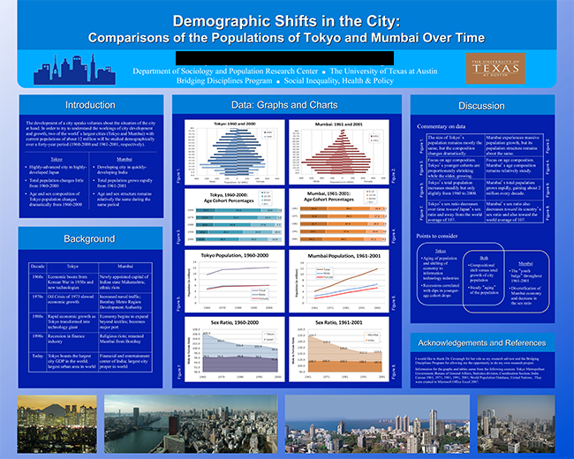
Notes:
Decent, not perfect
Colors are distracting.
Graphs and viz look pretty nice.

Slide 12
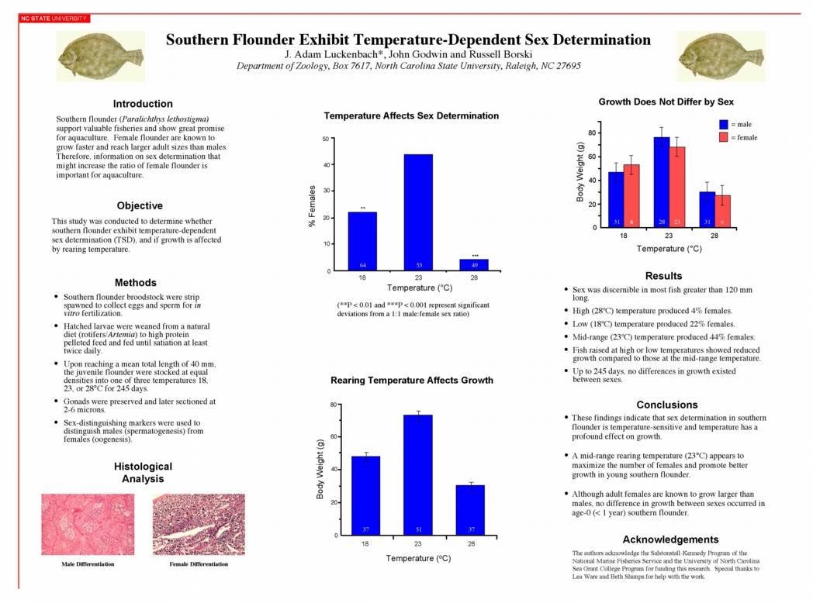
What does Good, Simple Poster Looks like
From: https://projects.ncsu.edu/project/posters/examples/Flounder/
Notes:
Decent, not perfect
Colors are distracting.
Graphs and viz look pretty nice.
City pictures not entirely necessary

Slide 13
Notes:
Simple, not eye-popping, but contains the most important ideas.
Can understand this with or without the presenter there.
Really like the Graph titles giving the conclusion

Slide 14
Creating Effective Visualizations

Slide 15
Important things to keep in Mind
Like the poster, data visualizations are all about getting your main point across.
This is very difficult to do with raw numbers and sometimes tricky to do with summary statistics
Choose the right visualization
Illustrate the point to your audience, should not need to take much deciphering on their part

Slide 16
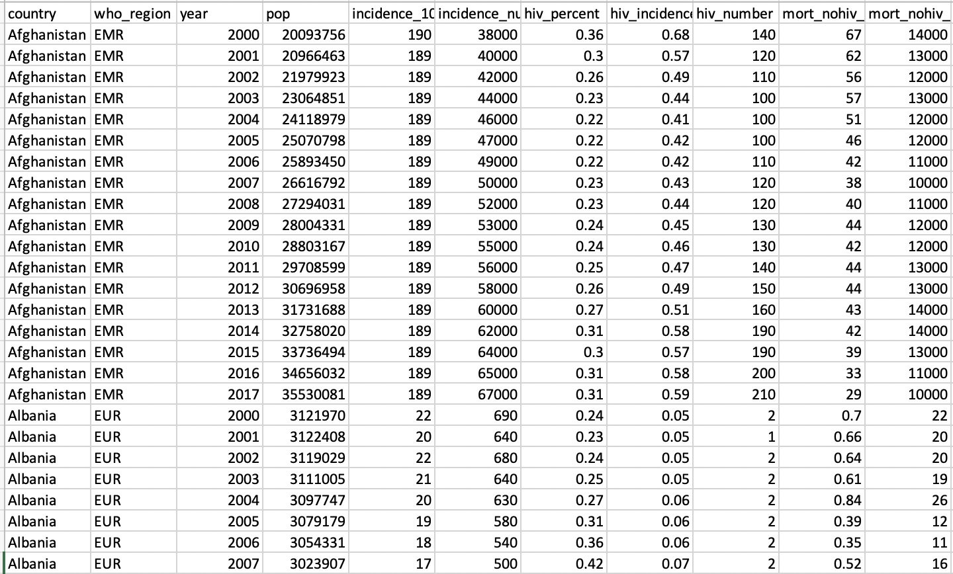
Raw data → Picture for communication
Notes:
Why do we even need viz? BC looking at raw data does not help us decipher meaning.
Purpose of a viz: Communication: Make new ideas pop into the heads of audience

Slide 17
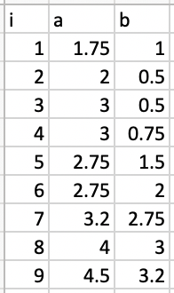
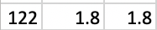
.
.
.
Notes:
Figure out what relationship these 3 variables have.
We have choices in how to visualize and those choices are important

Slide 18
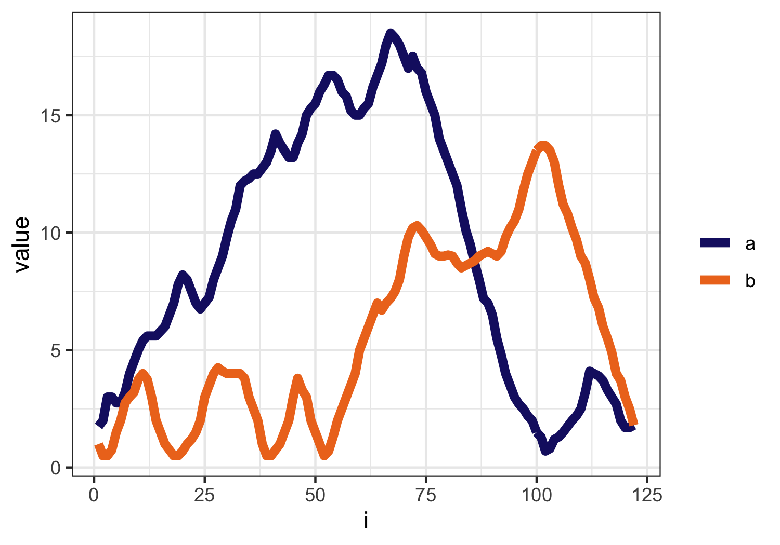
Notes:
Here we have graphed the variable i along the x axis and have plotted the variables A and B as lines. Looks nice, but maybe not the best way to show the relationship between A and B
What if instead of mapping the variable I to the x-axis, we mapped a to the X-axis and b to the Y-axis?

Slide 19
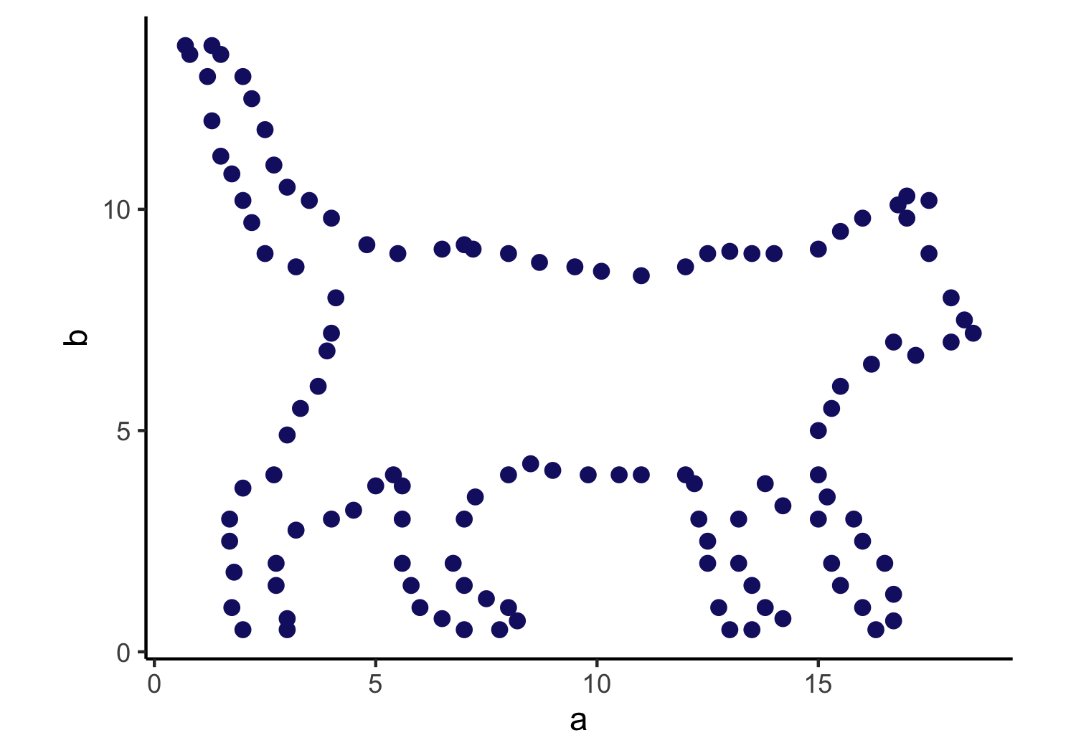
Notes:
AHA!
Pre-attentive processing – you see it before you think it. Subconscious accumulation of data
Best data viz makes use of pre-attentive processing of the effect that you want the audience to grasp

Slide 20
A graph is an encoding of the data
Your choice of encoding matters

Slide 21
Consider the story of your data viz
Often it is comparison between groups
Make that comparison the easiest

Slide 22
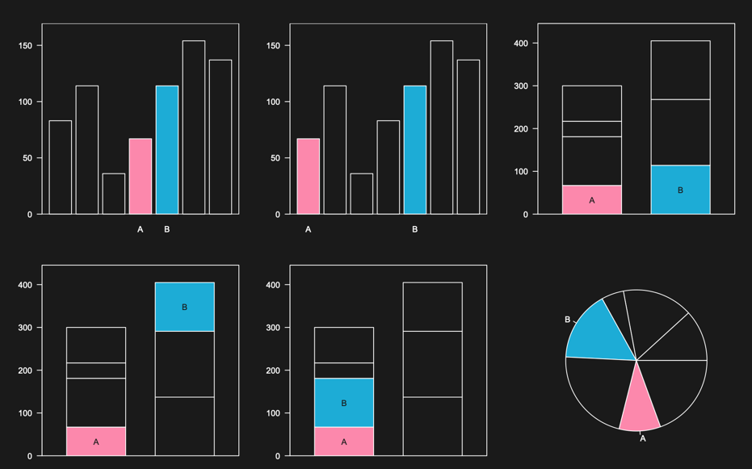
Where is the comparison easiest? Why?

Slide 23
There are many ways to differentiate and illustrate differences between groups in your data:
Position on a common scale
Position on identical but misaligned scales
Length
Angle / slope
Area
Volume or density or color saturation
Color hue

Slide 24
There are many ways to differentiate and illustrate differences between groups in your data:
Position on a common scale
Position on identical but misaligned scales
Length
Angle / slope
Area
Volume or density or color saturation
Color hue

Slide 25

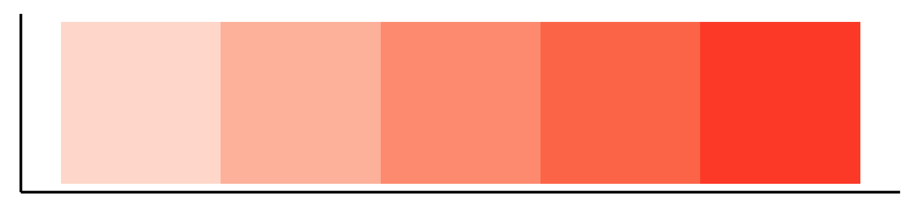

Color is really 3 things
Intensity
Saturation
Hue
Notes:
Luminance = brightness
Saturation = amount of color
Hue = color

Slide 26
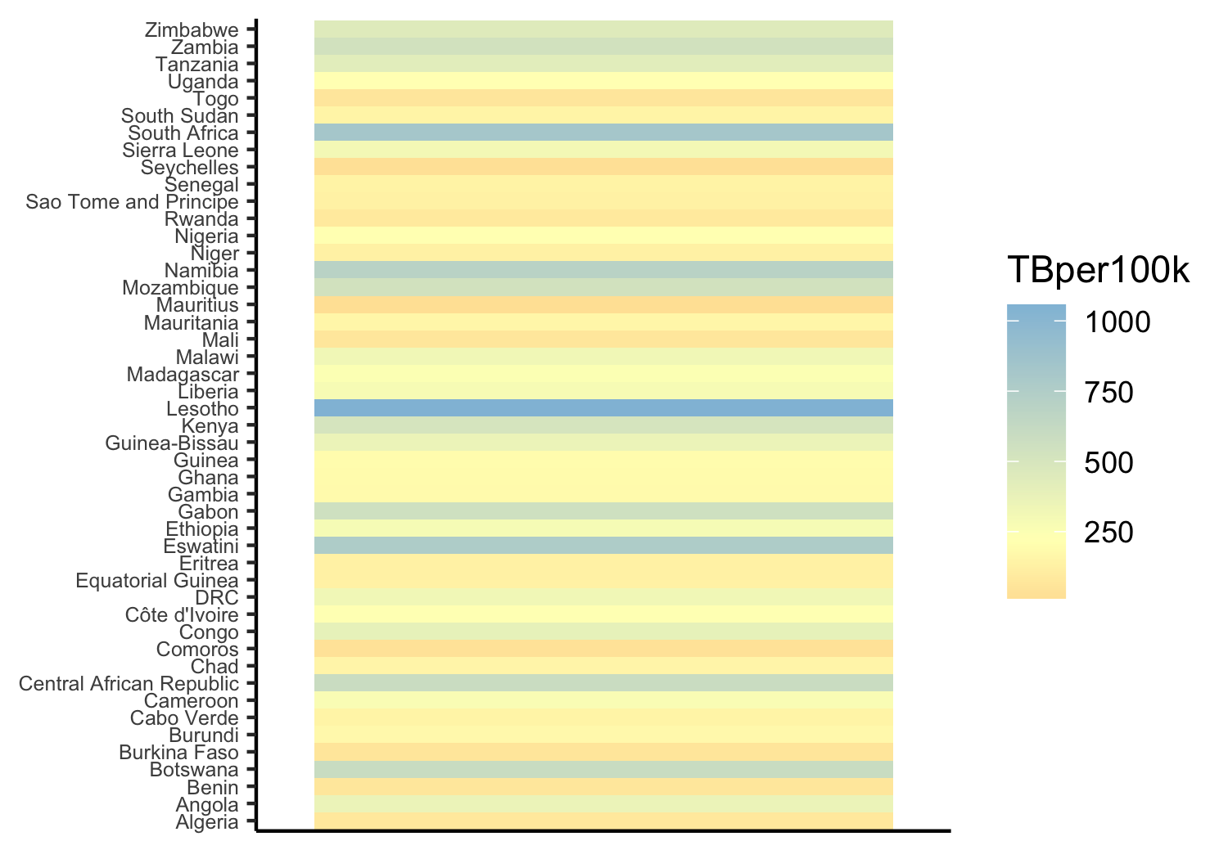
Notes:
HUE. Some of these you can do, but they are very slow because this is a table lookup. Hue does not inherently have an intuitive order.
If we use a hue scale that adds in luminance as an additional channel, so low luminance (dark) at bottom and high luminance (bright) at the top, that can already help to make the scale more understandable

Slide 27
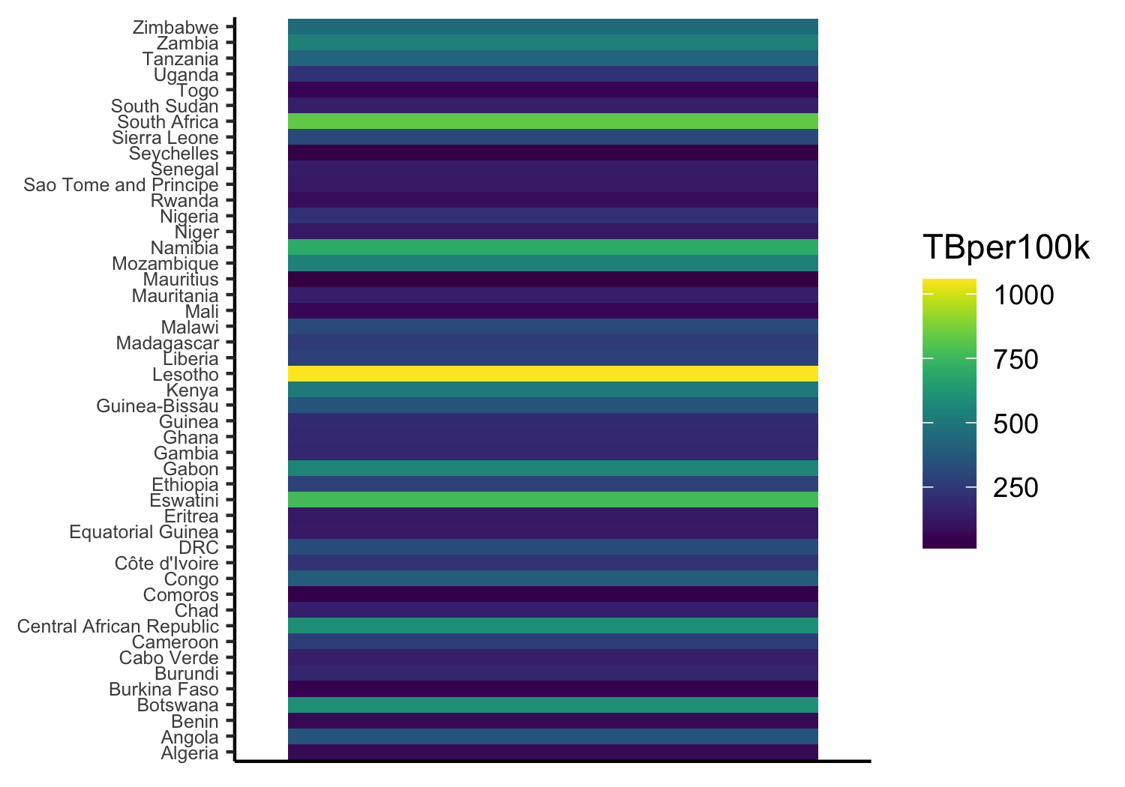

Notes:
HUE. Some of these you can do, but they are very slow because this is a table lookup. In general, hue does not have a natural order but this color scale from dark blue to bright yellow makes use of luminance too so that helps our eye establish an intuitive hierarchy

Slide 28
Alphabetical order is almost never the correct order

Slide 29
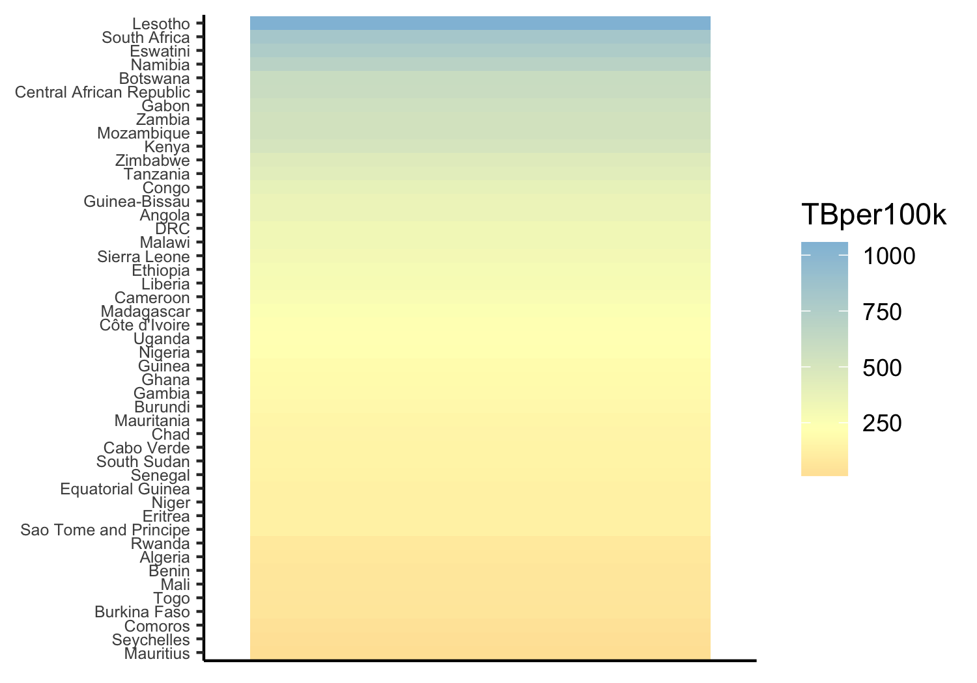

Slide 30
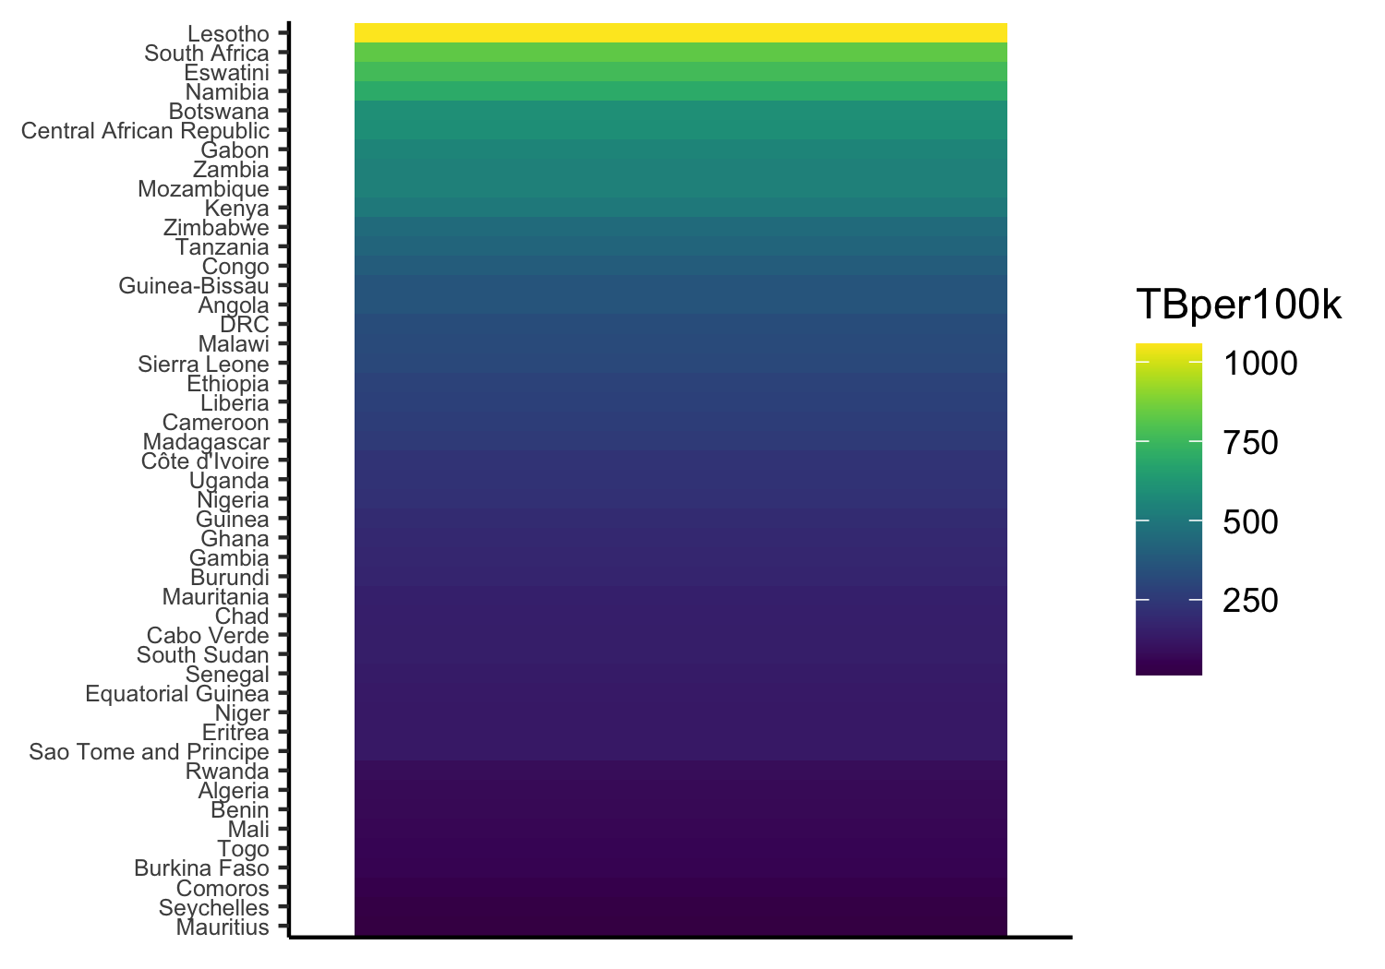

Slide 31
There are many ways to differentiate and illustrate differences between groups in your data:
Position on a common scale
Position on identical but misaligned scales
Length
Angle / slope
Area
Volume or density or color saturation
Color hue

Slide 32
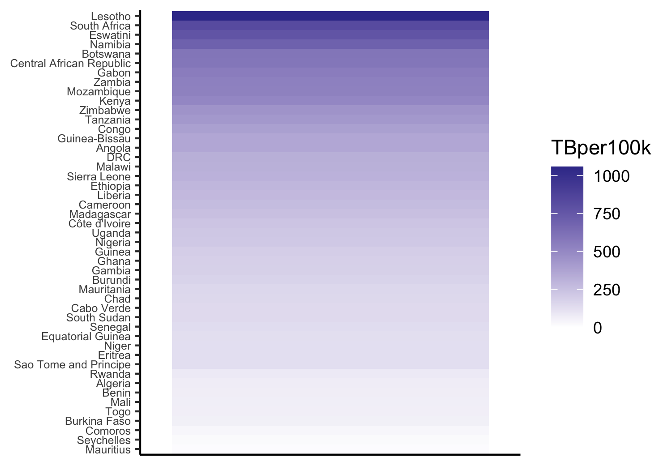
Notes:
I slightly altered the previous plot so that the zero TB means zero saturatuion, which is how we intuitively want to read that saturation legend. Can start to do ratioing (provided 0 color = 0 TB).

Slide 33
There are many ways to differentiate and illustrate differences between groups in your data:
Position on a common scale
Position on identical but misaligned scales
Length
Angle / slope
Area
Volume or density or color saturation
Color hue

Slide 34
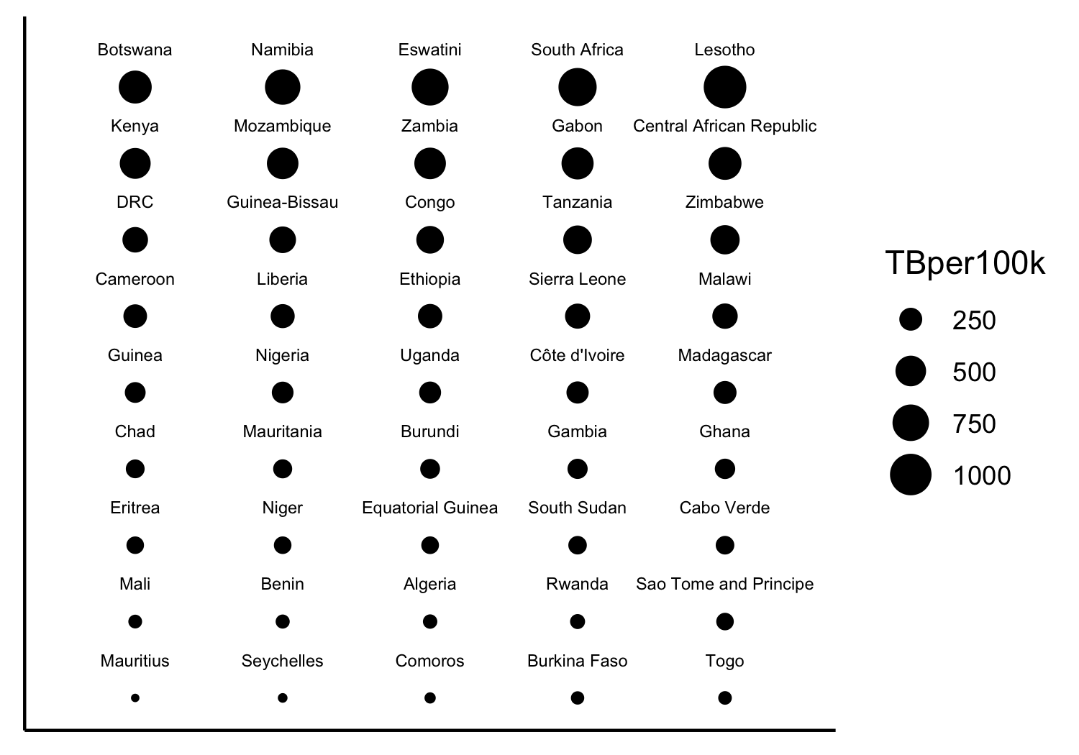
Notes:
AREA. Ratioing is possible with 2D area. Needs to be done right though! Scaled the AREA (not the radius or diameter). Scaled so that 0TB = 0area

Slide 35
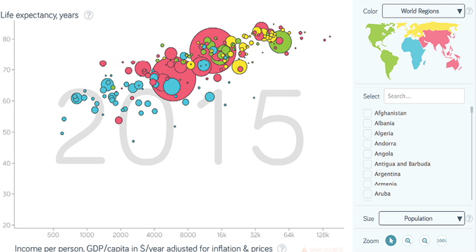
Notes:
Hans Rosling gapminder dataset

Slide 36
Pie charts are always a mistake
Use a table instead (for data with few categories)
Use a dot plot (for data with lots of categories)
Notes:
Encode information as angles (4th on the list)

Slide 37
Notes:
This lovely pie chart shows the proportion of the world’s population in each of the different regions in the tuberculosis dataset. This is not any better than a table.

Slide 38
Notes:
Certainly the donut should be avoided since now the area of a complex shape encodes the proportion of the population

Slide 39
Region | Proportion
WPR | 0.26
SEA | 0.26
AMR | 0.14
EUR | 0.13
AFR | 0.12
EMR | 0.09

Slide 40
Notes:
Certainly, this information (population proportion for 218 countries) must be in a table or summarized in a different way. Dot Plots shown later are quite helpful.

Slide 41
There are many ways to differentiate and illustrate differences between groups in your data:
Position on a common scale
Position on identical but misaligned scales
Length
Angle / slope
Area
Volume or density or color saturation
Color hue

Slide 42
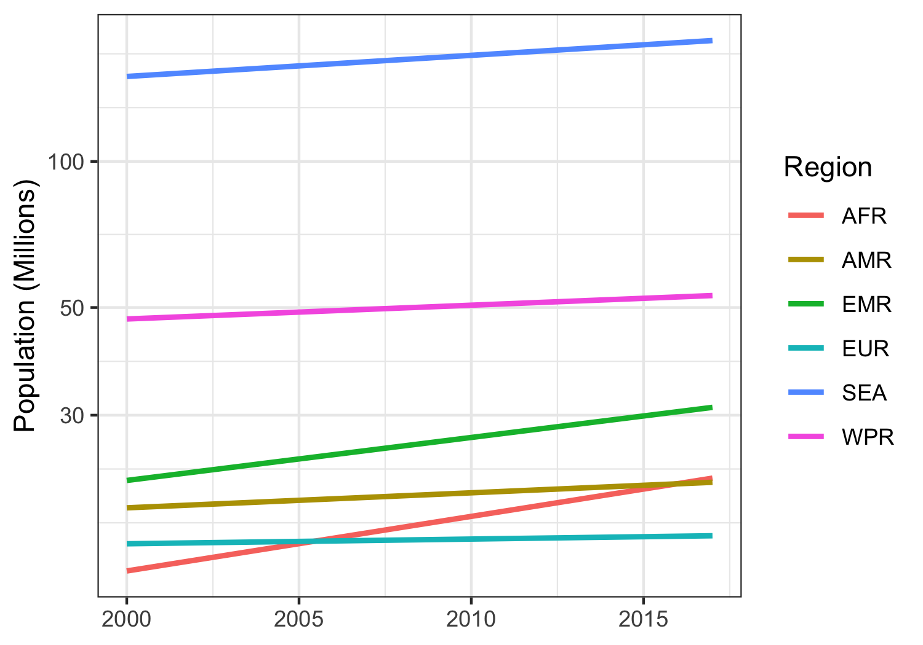
Notes:
Pop growth is encoded as angle
Is the Eastern Mediterranean region growing faster or slower than South East Asia? – Faster?? But it is hard to tell because the lines are far from each other

Slide 43
There are many ways to differentiate and illustrate differences between groups in your data:
Position on a common scale
Position on identical but misaligned scales
Length
Angle / slope
Area
Volume or density or color saturation
Color hue

Slide 44
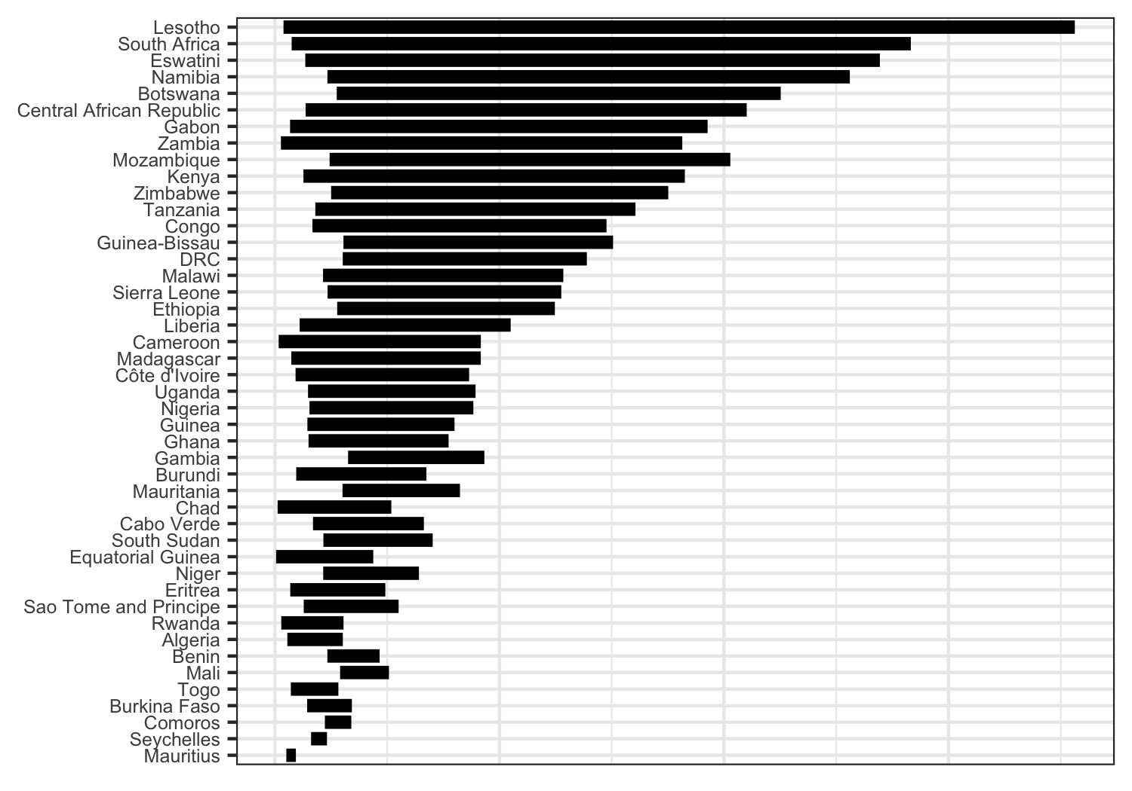
200 cases of TB per 100K
Notes:
Can get accurate ratioing – better than angle or area
Togo looks to be about double Comoros
BUT – discrimination is still tough
Are Eritrea and Sao Tome & Principe same or different? – hard to tell because not on common baseline

Slide 45
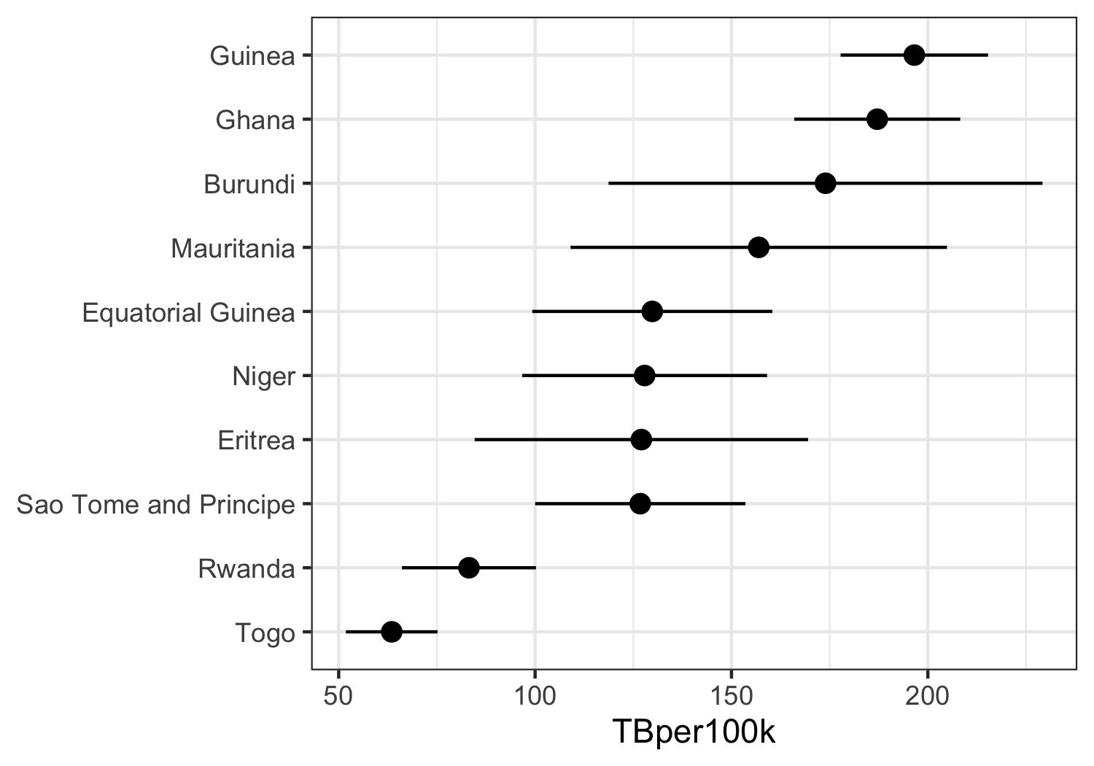
Notes:
Length of unaligned line segments is actually common
Comparing error of Ghana with that of Rwanda is difficult though that is exactly what we are asking viewers to do

Slide 46
There are many ways to differentiate and illustrate differences between groups in your data:
Position on a common scale
Position on identical but misaligned scales
Length
Angle / slope
Area
Volume or density or color saturation
Color hue

Slide 47
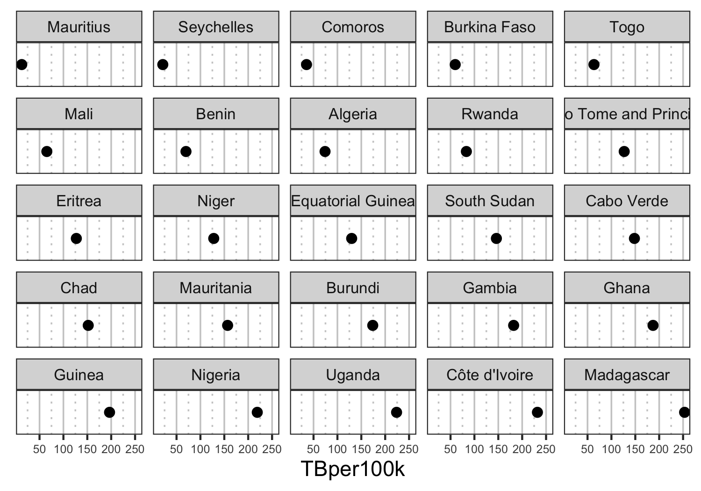
Notes:
Now we can tell diff between two very close values. Comoros is below 50 while Togo is above. In this case gridlines are extremely important to our ability to detect the differences

Slide 48
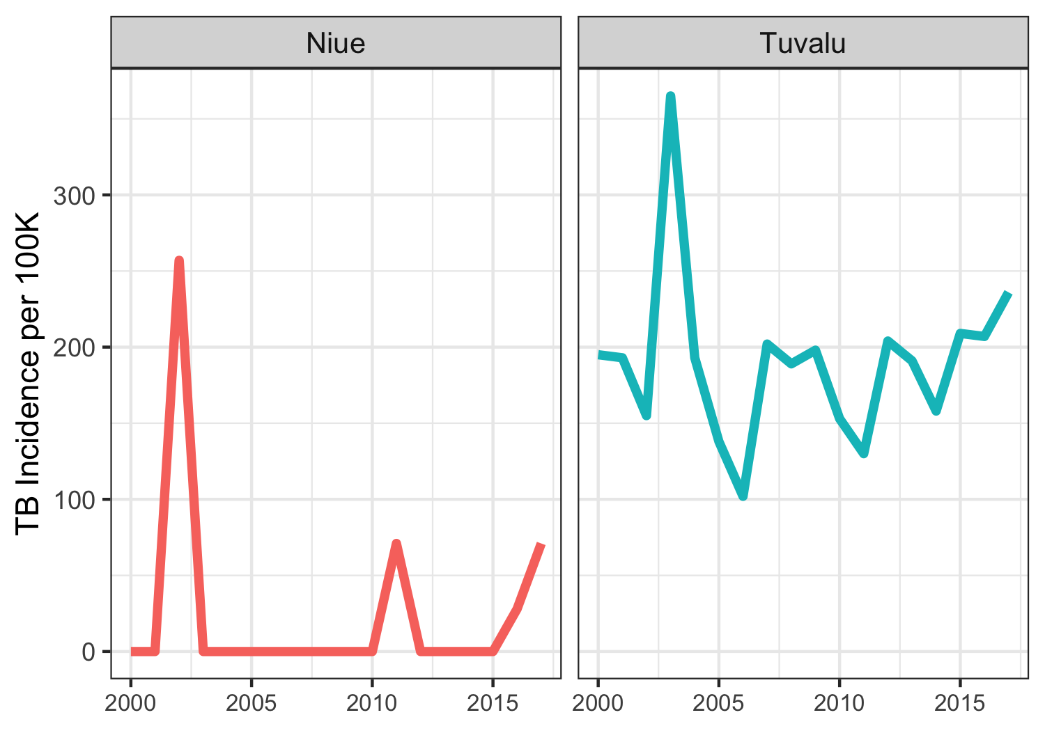
Notes:
Is the peak in the same years in each of these two countries? We can tell that Tuvalu has its peak after Niue but it requires two lookups

Slide 49
There are many ways to differentiate and illustrate differences between groups in your data:
Position on a common scale
Position on identical but misaligned scales
Length
Angle / slope
Area
Volume or density or color saturation
Color hue

Slide 50
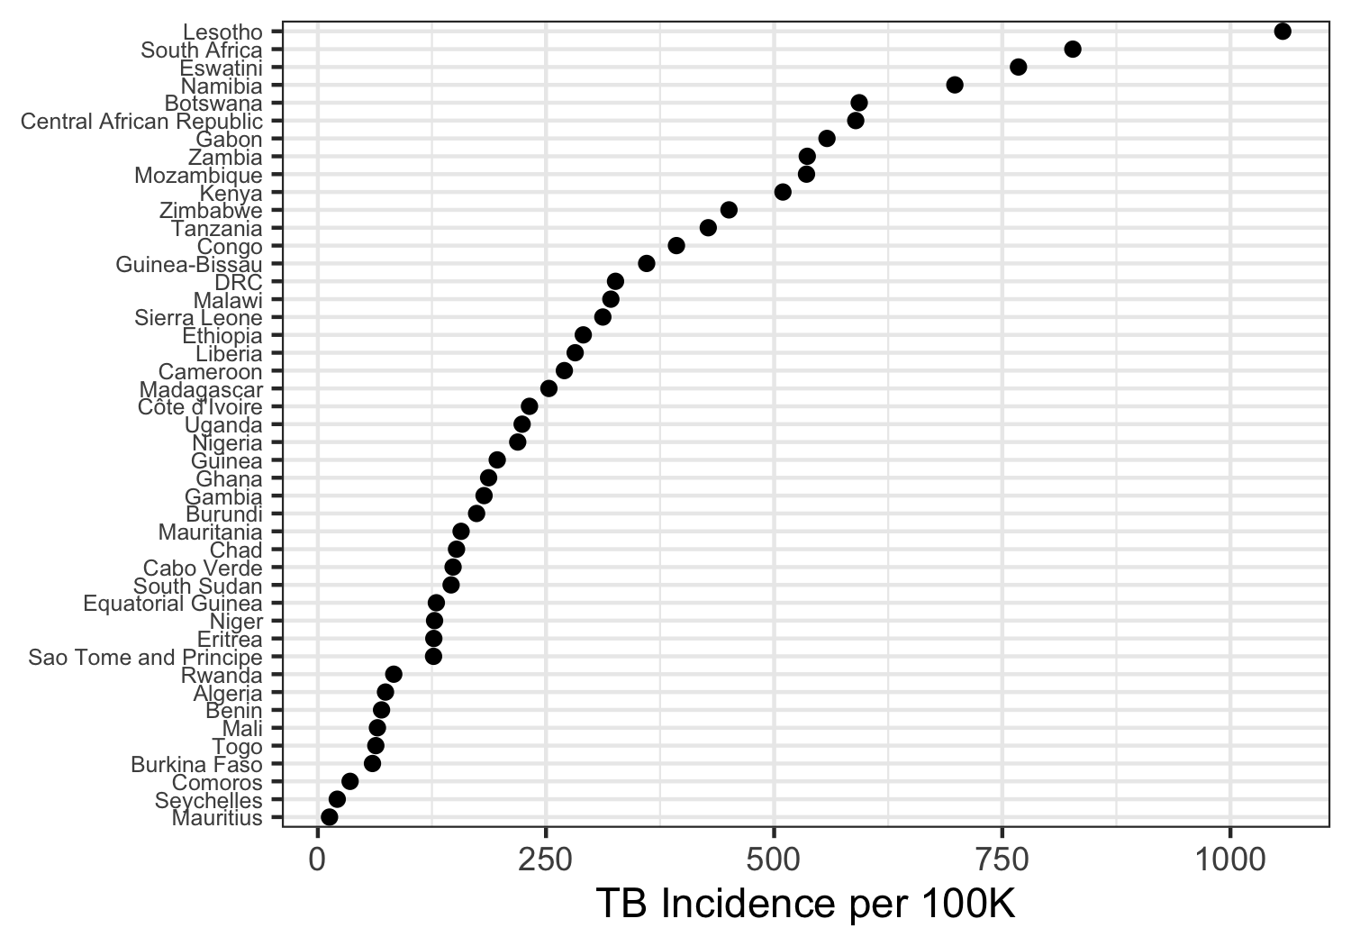
Notes:
Ratioing, ranking, and discrimination are easy!

Slide 51
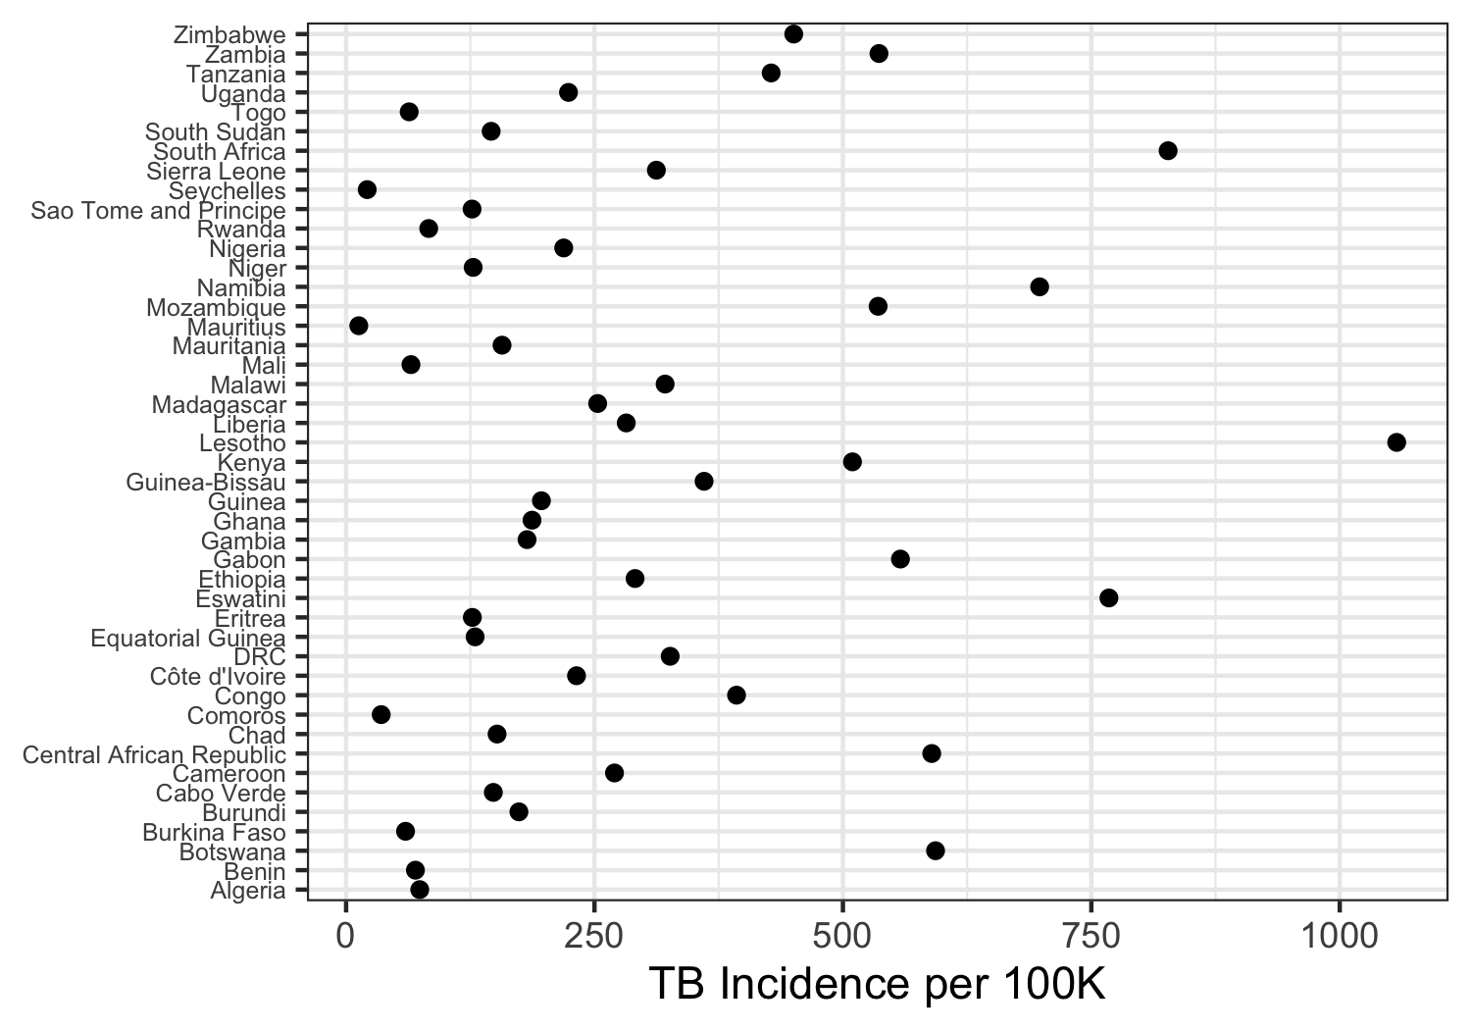
Notes:
Remember that ordering is still critical

Slide 52
Be careful with stacking

Slide 53
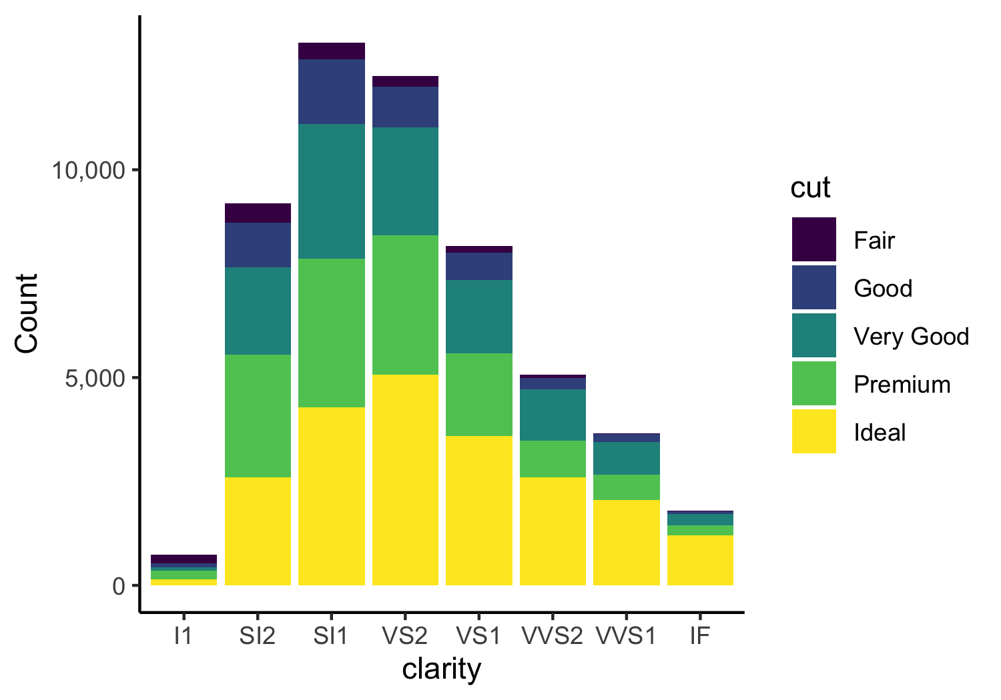
Notes:
This plot most easily shows the number of diamonds in each clarity class (length of bars)
But the count within cut/clarity combo is hard. Are there more diamonds in the Premium cut class in the SI2 or SI1 clarity group? We can’t tell
Why?
Because decoding lengths on misaligned scales is harder than decoding lengths on a common scale

Slide 54
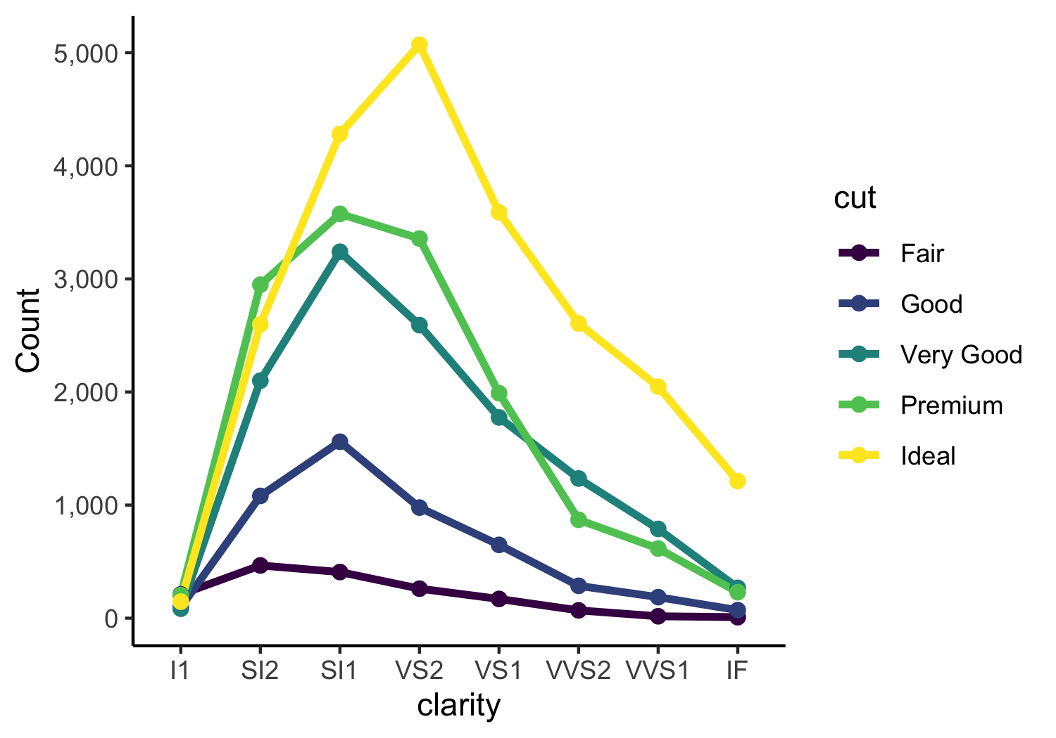
Notes:
Parallel coordinates plot encodes the count of each clarity/cut class as the position on a common scale
You have lost info about totals in each clarity group, so add that in as a separate line or separate plot if you need that info

Slide 55
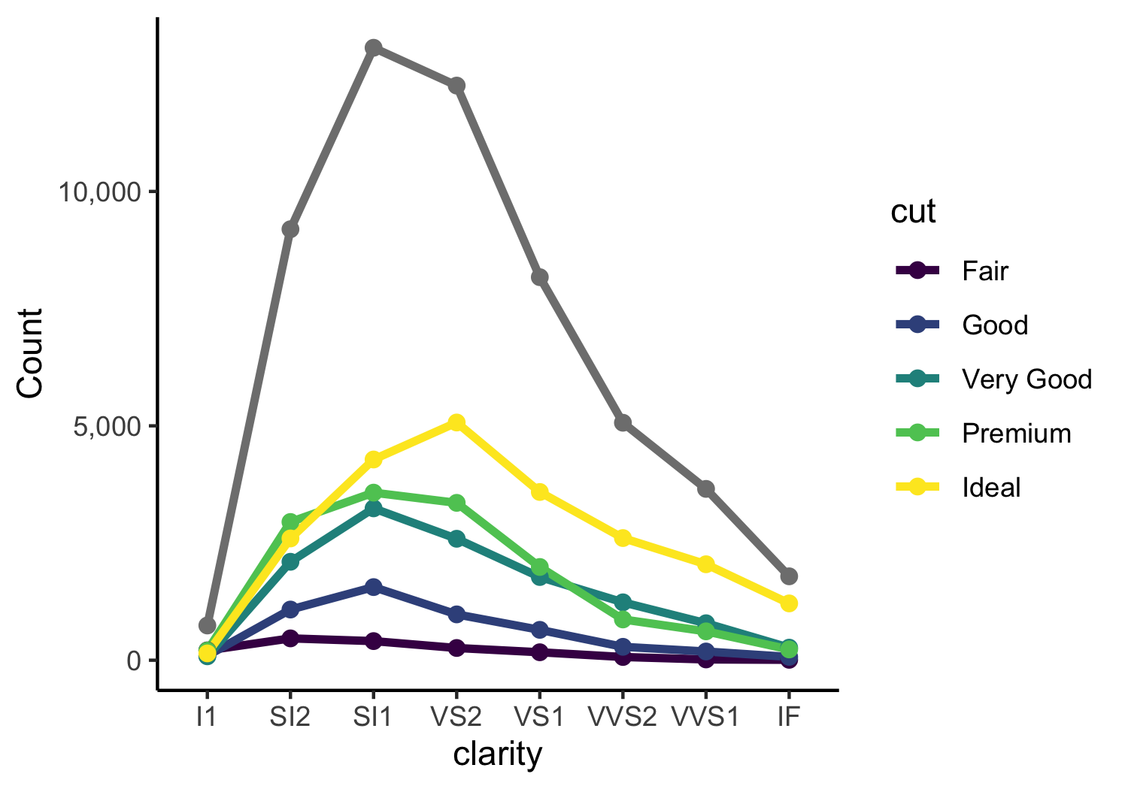

Slide 56
“Above all else, show the data”
- Tufte

Slide 57
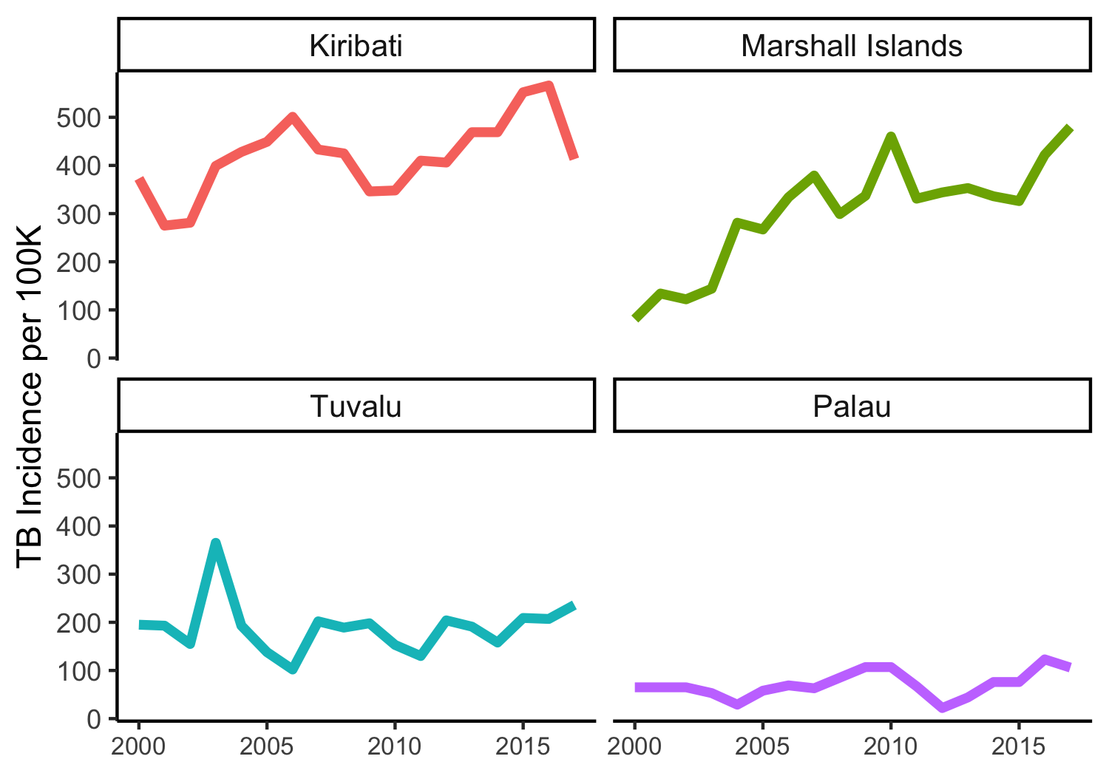
Notes:
Should we have gridlines at all?
How does the peak in Tuvalu’s TB incidence compare to the same time period in Kiribati – hard to tell without gridlines

Slide 58
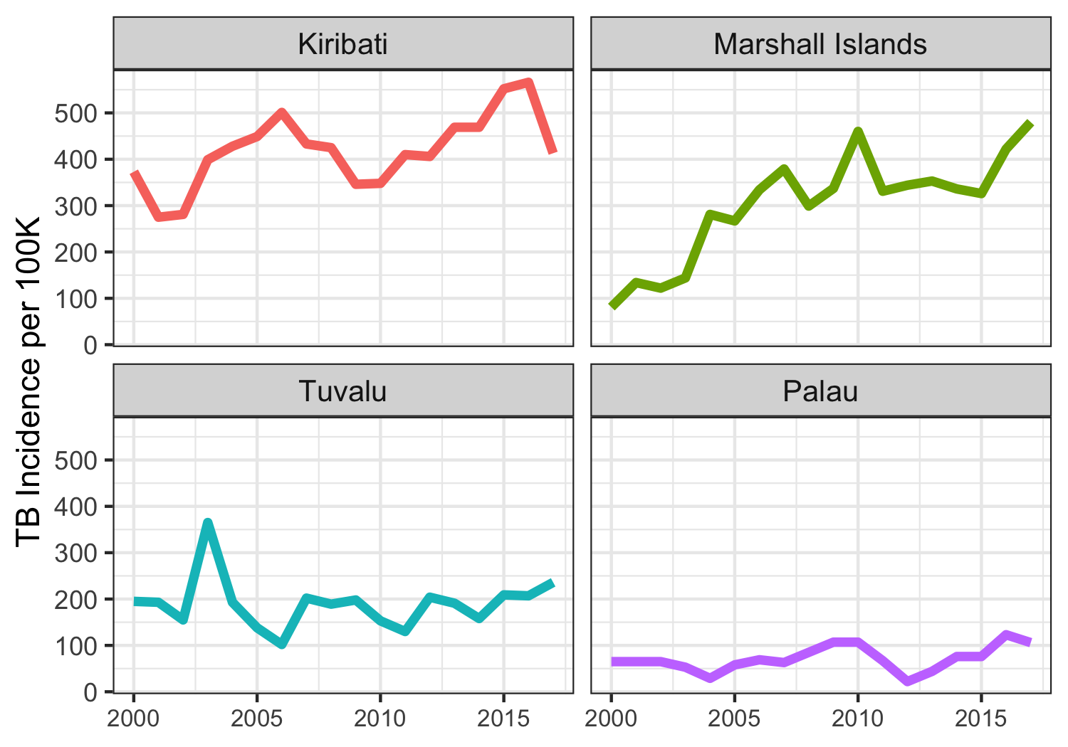
Notes:
Same plot but with gridlines. With the simple addition of gridlines we are able to see that in 2003 Tuvalu’s TB incidence peak is above 350 while in Kiribati in 2003 it is up at 400. Because we are looking within a smaller box, we are more easily able to detect small differences

Slide 59
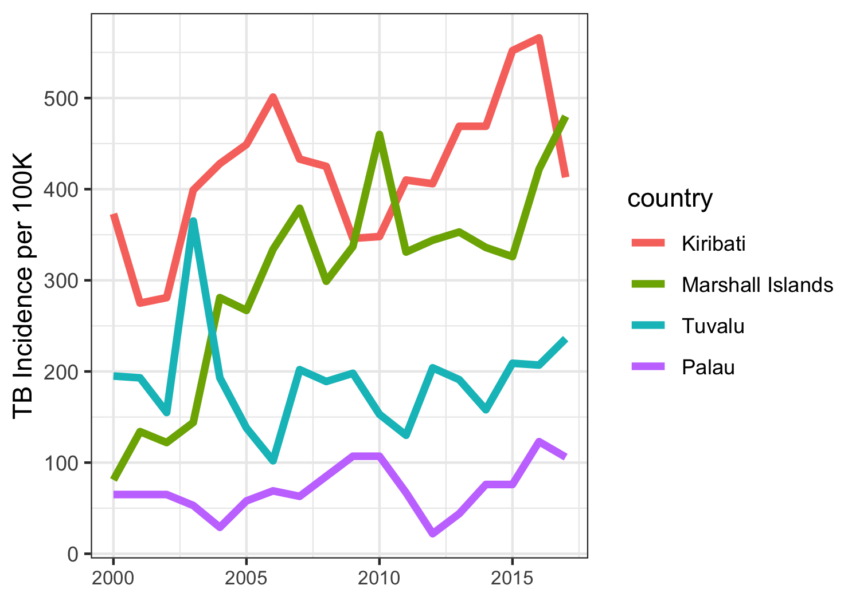
Notes:
Even better would be all 4 countries on the same plot so we don’t have to do 2 separate lookups

Slide 60
“Erase non-data ink,
within reason”
- Tufte

Slide 61
Should we include 0 on the axis?

Slide 62
Notes:
Yes, include 0 since we are relying on preattentive processing of color saturation to tell us the incidence of TB relative to 0

Slide 63
Notes:
Again, zero should be included since the size of the area of the dot corresponds directly to the TB incidence relative to 0. 0 TB would have 0 area

Slide 64
Notes:
What about in a plot like this where the encoding is position on a common scale. Is including zero on the scale important? For the tuberculosis dataset, we did include 0 but only because it was close to the minimum tb value

Slide 65
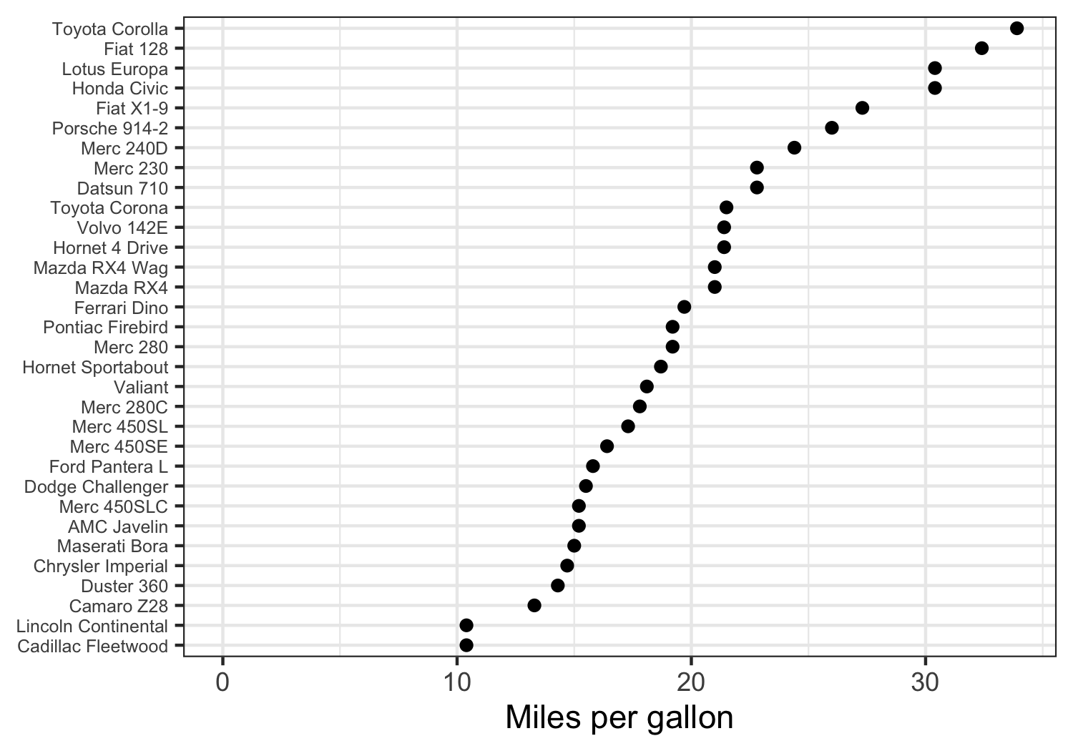
Notes:
In this dataset, the minimum miles per gallon any model of car gets is above 10. Because we are comparing the positions with each other rather than the length of the bars, including zero here is not necessary and just wastes space.

Slide 66
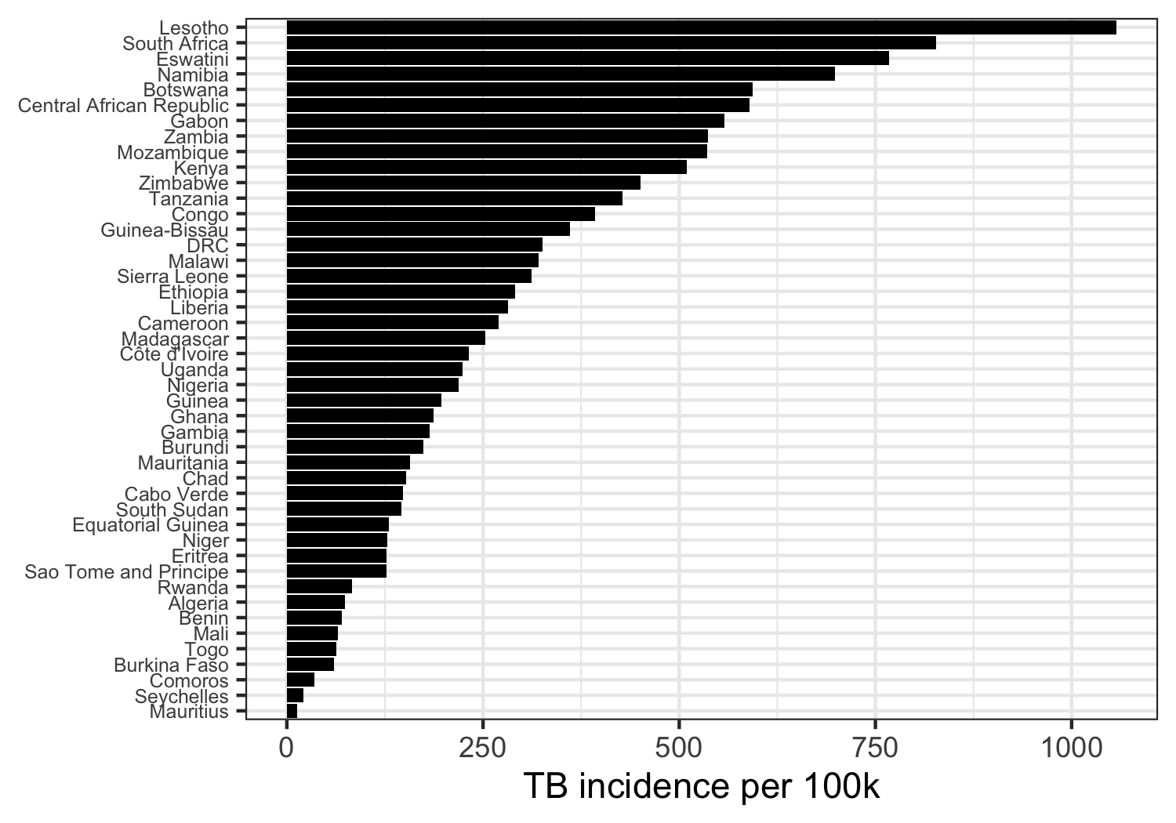
Notes:
Bar chart – people say that readers are comparing position of the ends of the bar but if you draw the bar, I say you are encouraging people to detect and compare the lengths of the bar. Therefore, they should start at zero

Slide 67
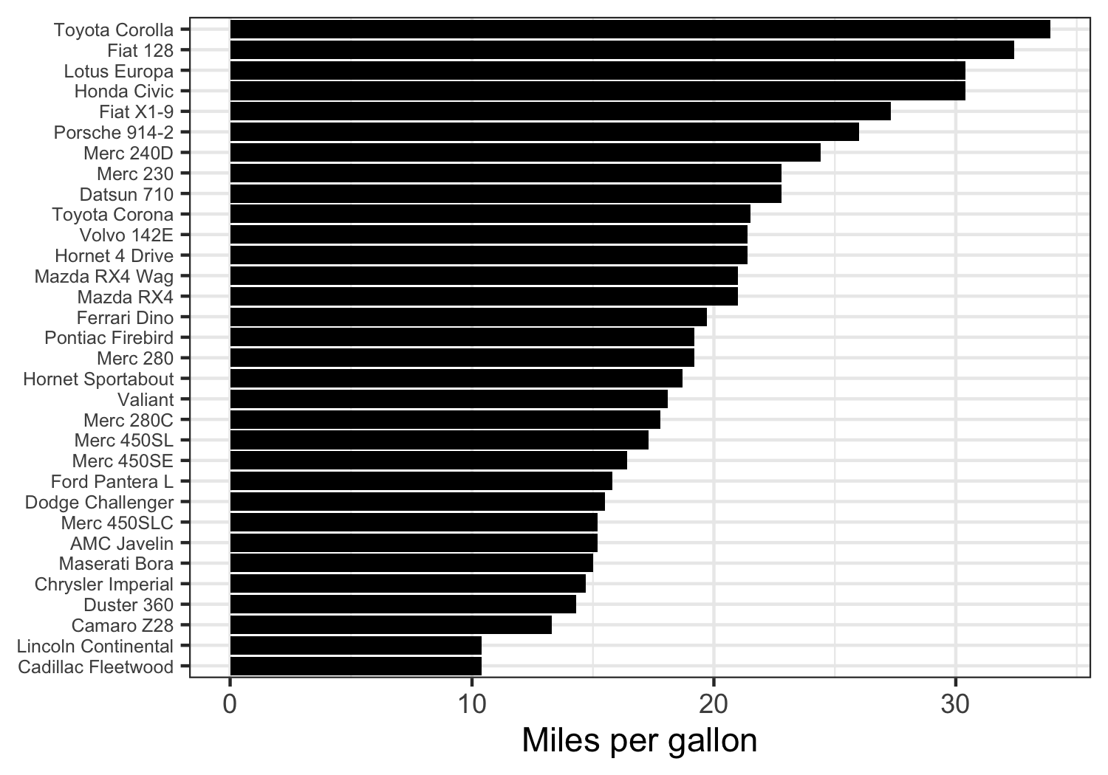
Notes:
Bar chart – people say that readers are comparing position of the ends of the bar but if you draw the bar, I say you are encouraging people to detect and compare the lengths of the bar. Therefore, they should start at zero

Slide 68
Should we include 0 on the axis?
If encoding relies on pre-attentive processing of size or intensity, you must include 0 to not mislead
If encoding relies on position, you decide

Slide 69
Other THoughts
Do not put a question number as an axis label
White space is good, but optimize the space that you have
Legends are not always necessary, use of color and labels can really help
Show all of your data if you do not have much

Slide 70
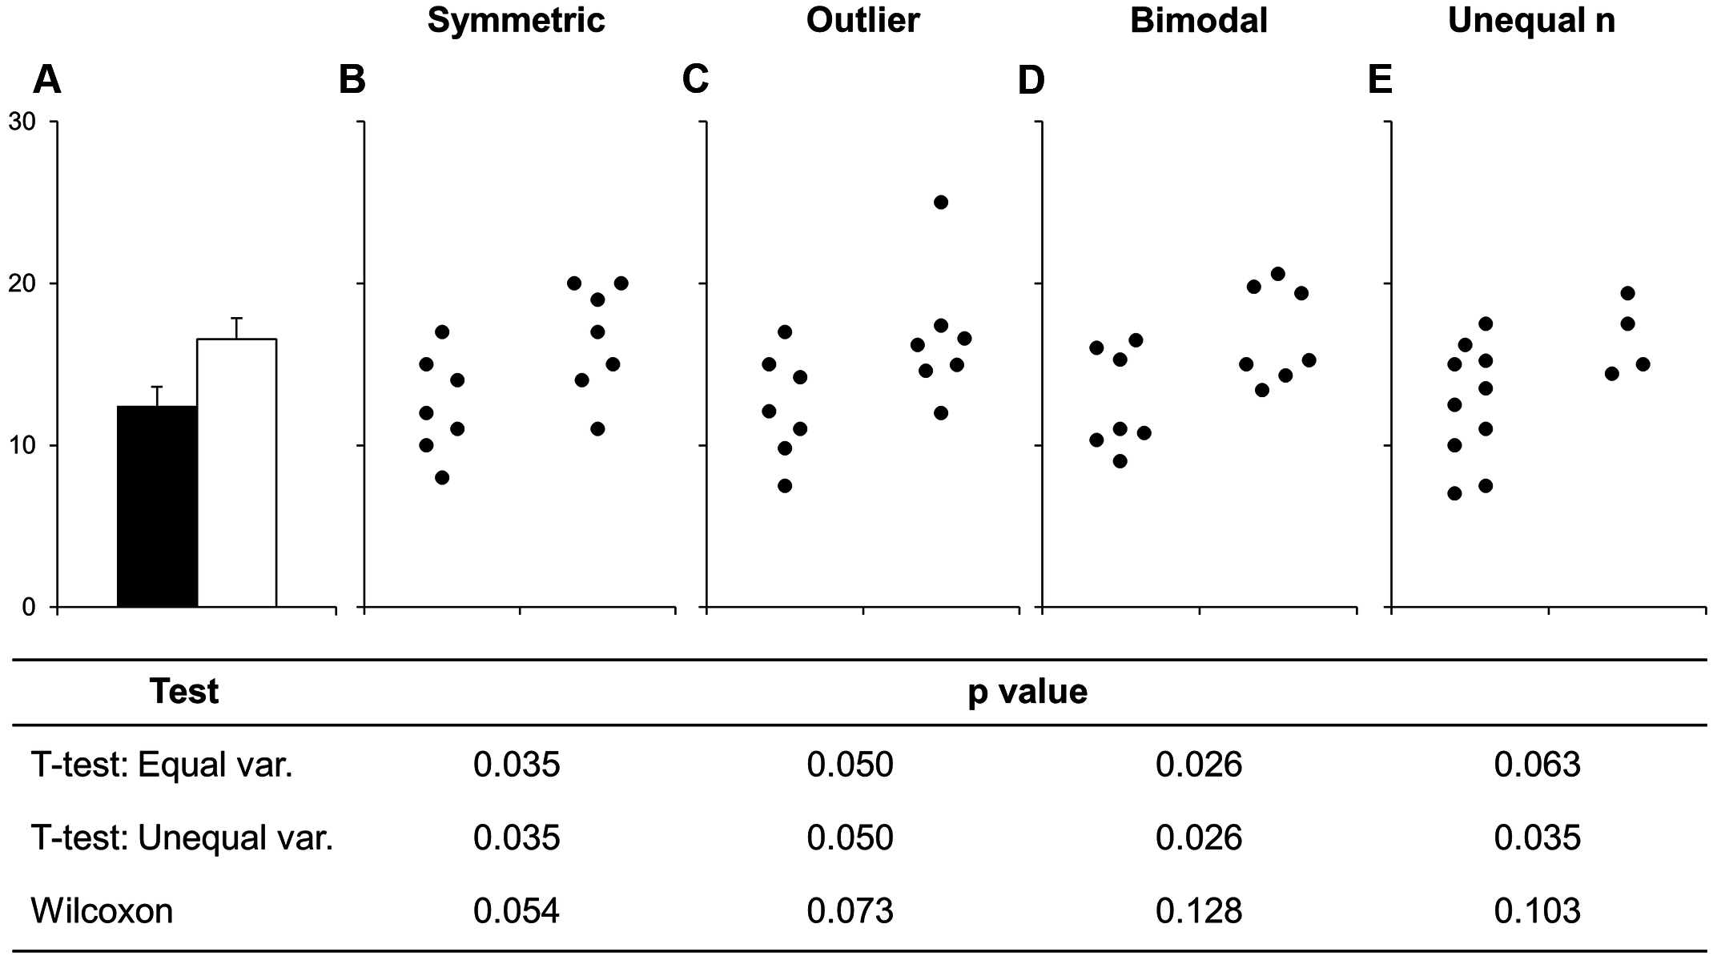
No more bar plots where n < 10
Summary statistics are only meaningful when there are enough data to summarize
Weissgerber TL, Milic NM, Winham SJ, Garovic VD (2015) Beyond Bar and Line Graphs: Time for a New Data Presentation Paradigm. PLoS Biol 13(4): e1002128. https://doi.org/10.1371/journal.pbio.1002128

Slide 71
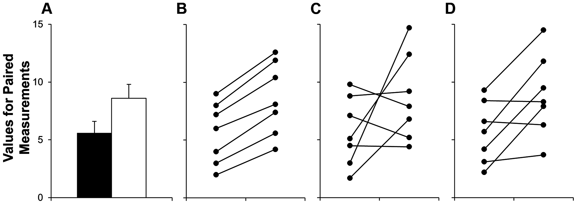
Show paired data as such
Weissgerber TL, Milic NM, Winham SJ, Garovic VD (2015) Beyond Bar and Line Graphs: Time for a New Data Presentation Paradigm. PLoS Biol 13(4): e1002128. https://doi.org/10.1371/journal.pbio.1002128

Slide 72
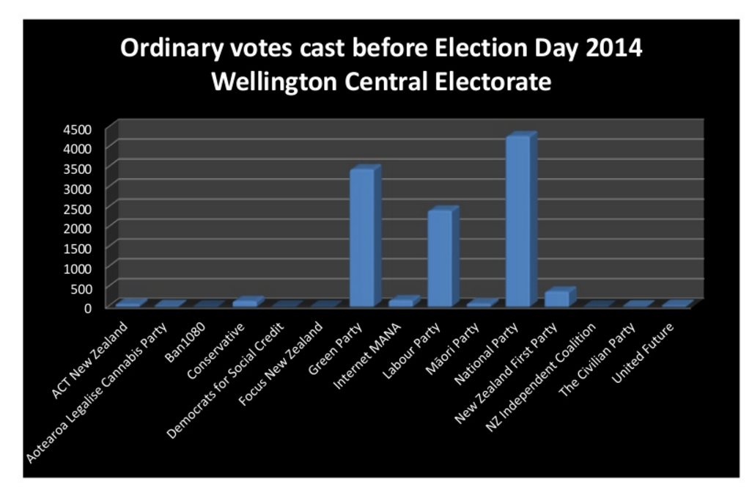
Improve this plot

Slide 73
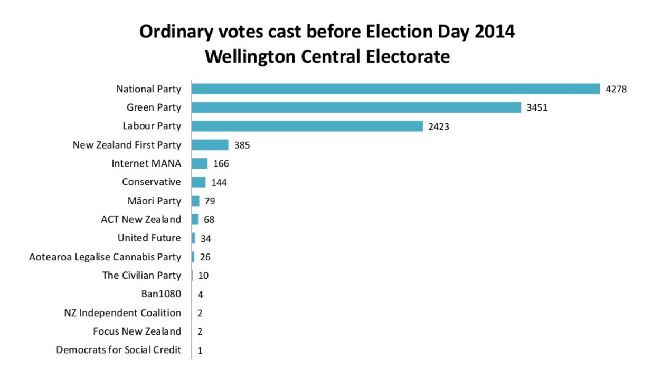

Slide 74
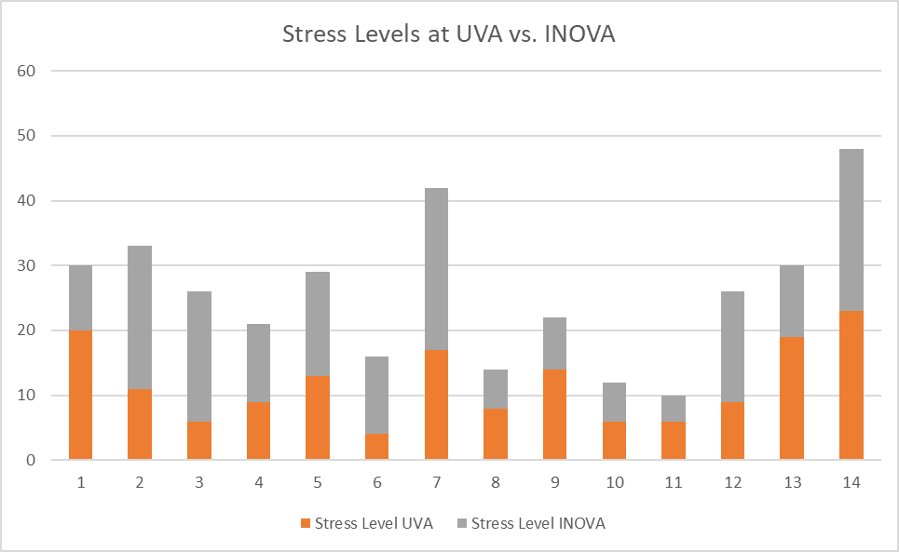
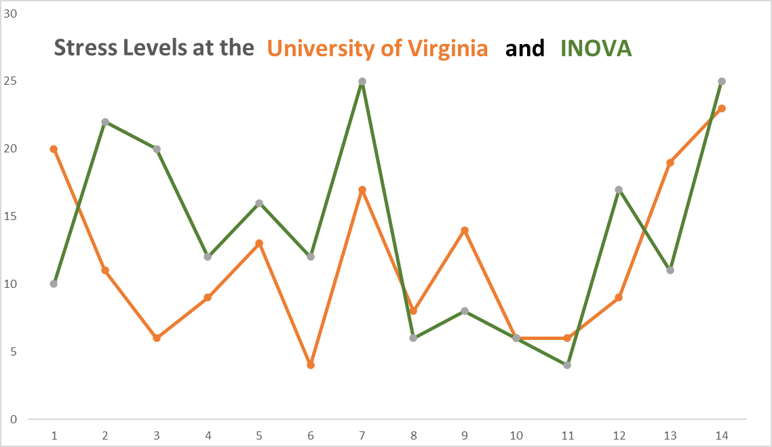
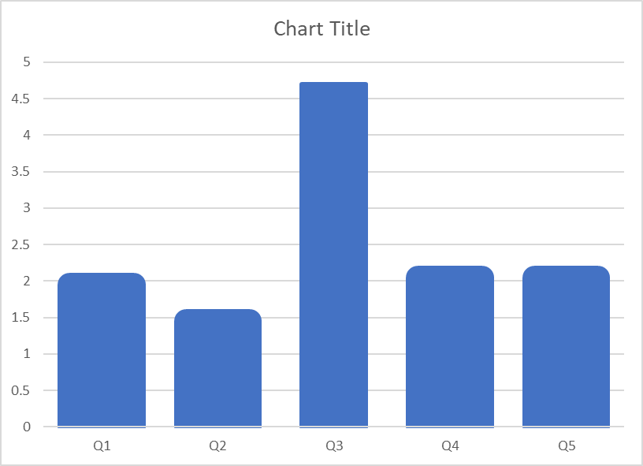
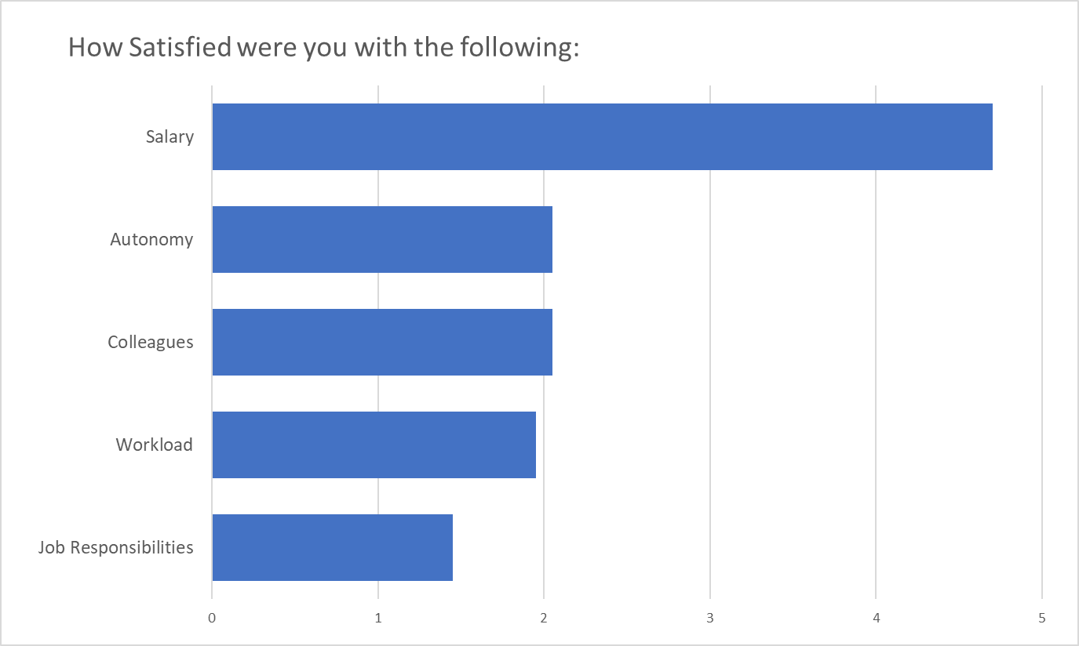
Let’s try this out in excel

